Slide 1


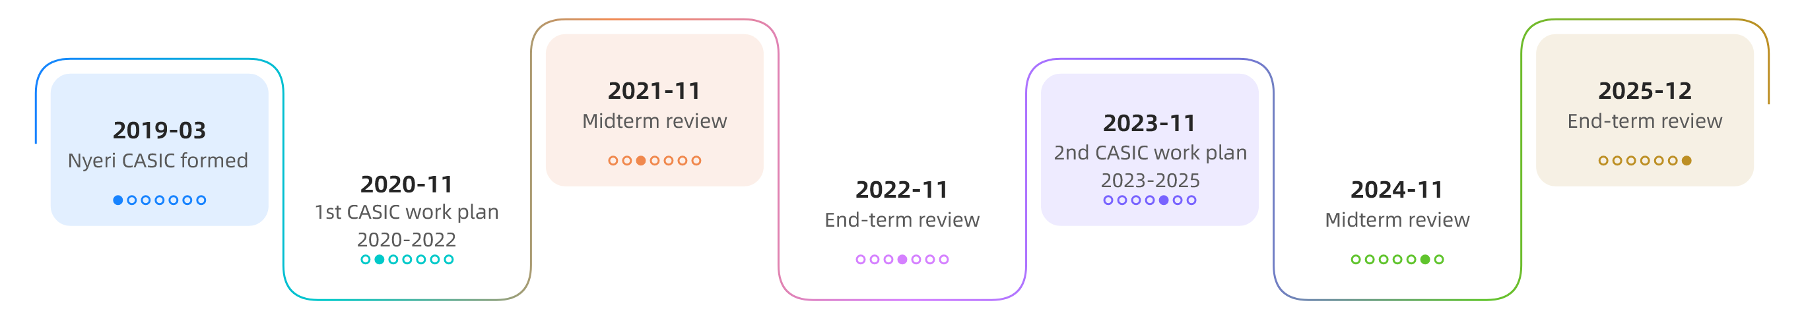
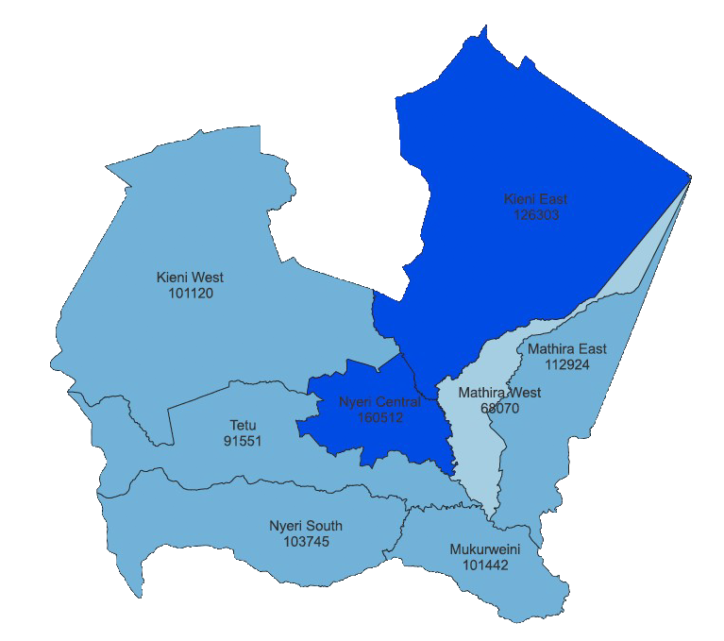

Embedding Monitoring, Evaluation, Accountability and Learning (MEAL) in Subnational AMR Work Plans:
Lessons from Nyeri County, Kenya
Oscar Agoro¹, Boniface Macharia¹, Nahashon Gicheru¹, James Kimani², Anthony Muguro³, Nelson Muriu¹
Department of Medical Services and Public Health, Nyeri County
Department of Water, Environment and Climate Change, Nyeri County
Department of Agriculture, Livestock and Aquaculture Development, Nyeri County
BACKGROUND
Antimicrobial resistance is a major health security threat that requires coordinated action across human, animal, and environmental sectors. Kenya’s AMR National Action Plan (2023–2027) prioritises governance, surveillance, infection prevention, and optimal antimicrobial use, supported by a structured monitoring and evaluation framework. In Nyeri County, the AMR NAP was implemented through the County Antimicrobial Stewardship Interagency Committee (CASIC) across two work plan cycles, 2020–2022 and 2023–2025. The second cycle introduced a structured Monitoring, Evaluation, Accountability and Learning approach to strengthen implementation tracking, coordination, and adaptive management. This abstract presents Nyeri County’s experience in embedding MEAL in subnational AMR work planning and implementation.
RESULTS Cont’d…
B. CASIC Work Plan 2023–2025
Midterm Review End term Performance
OBJECTIVE:
To demonstrate the value of embedding MEAL systems in subnational AMR work plans
To assess how MEAL improves implementation, coordination and learning
To generate lessons to inform future AMR planning and scale-up
STUDY AREA:
Nyeri County, Kenya
Population: 865,668 (2025 est.)
Eight sub-counties
Predominantly agricultural economy
One Health Coordination through CASIC
Completed/On-track improved
53% 78%
STUDY DESIGN AND SAMPLING
Retrospective longitudinal implementation review
Census of all activities in CASIC work plans
Multisectoral stakeholder participation)
Data sources: work plans, reports, review reports, stakeholder inputs
Gains | Gaps
Governance and coordination Awareness and training Integration into planning and reporting systems | Surveillance systems Laboratory capacity IPC scale-up Antimicrobial use monitoring
METHODOLOGY
Review of two CASIC work plans (2020–2022 and 2023–2025) and associated midterm and end-term reports
Document review and structured performance assessment of activities
Stakeholder consultations
Use of standard activity status categories and performance tracking
DISCUSSION
Transition from system establishment to performance-driven implementation
2020–2022 cycle set up coordination structures but lacked structured tracking and feedback;
2023–2025 cycle introduced a defined MEAL framework with indicators, tools, and regular reviews
Improved visibility enabled early detection of delays and timely corrective action
Progress remained uneven across priority areas
Surveillance, laboratory systems, and antimicrobial use monitoring lagged behind
Gaps linked to limited financing, infrastructure constraints, and capacity limitations across sectors
RESULTS
A. CASIC Work Plan 2020–2022
Midterm Review
Early implementation momentum; uneven progress across sectors
Progress: awareness, training, structures, and IPC
Lag: Surveillance, laboratory strengthening, antimicrobial use monitoring
Environment activities had low implementation rates
End term Performance
Partial achievement of planned objectives; strong variation across domains
Appropriate antimicrobial use (human health): 100% implementation
Awareness (agriculture and environment): 86% implementation
Surveillance: 50% (human health) and 11% (agriculture)
Constraints in surveillance, laboratory systems, and enforcement
Challenges
Financing | Laboratory capacity | Governance structures | Covid-19 disruption | Weak M&E systems.
CONCLUSION
Embedding MEAL in subnational AMR work plans improves performance, accountability, and coordination
Nyeri CASIC experience shows structured monitoring and regular reviews increase activity completion and reduce delays
Sustained progress in surveillance and antimicrobial stewardship requires investment in laboratories, financing, and capacity
Strong MEAL systems are essential for effective implementation of Kenya’s AMR National Action Plan at county level.
<oscar.agoro@nyeri.go.ke>

